Slide 1


Department of Electronics and Communication Engineering
VLSI Design
COURSE CODE
Topic:
MOS Technology
Session - 2

Slide 2



AIM OF THE SESSION
To familiarize students with the basic idea about MOS Transistors and Their Varios Types
INSTRUCTIONAL OBJECTIVES
This Session is designed to:
Discuss the MOS Technology.
Describe the kinds of MOS Transistors and their Applications.
LEARNING OUTCOMES
At the end of this session, you should be able to:
Discuss MOS Technology and Their Uses.
Discuss the all kinds of MOS Transistor and their applications.
Summarize the theory of MOS Technology and Applications.

Slide 3
MOS Technology
MOS technology is considered as one of the very important and promising technologies in the VLSI design process.
The circuit designs are realized based on pMOS, nMOS, CMOS and BiCMOS devices.
These devices are based on the p-channel MOS transistors.
-Specifically, the pMOS channel is part of a n-type substrate lying between two heavily doped p+ wells beneath the source and drain electrodes.
-Generally speaking, a pMOS transistor is only constructed in consort with an NMOS transistor.
The nMOS technology and design processes provide an excellent background for other technologies.
-In particular, some familiarity with nMOS allows a relatively easy transition to CMOS technology and design.
The techniques employed in nMOS technology for logic design are like GaAs technology..
Therefore, understanding the basics of nMOS design will help in the layout of GaAs circuits

Slide 4
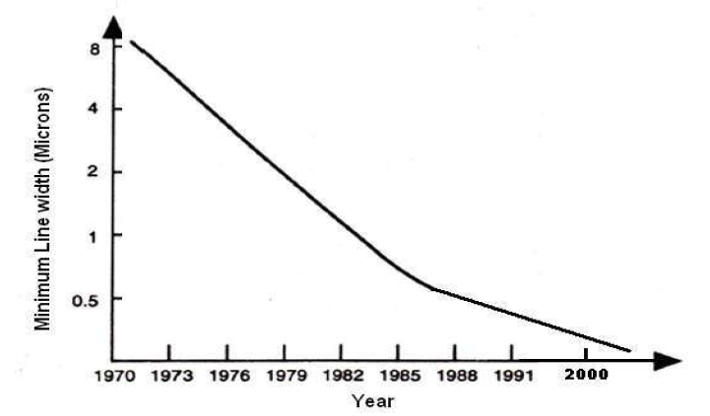
MOS Technology
In addition to VLSI technology,
-the VLSI design processes also provides a new degree of freedom for designers which helps for the significant developments.
With the rapid advances in technology the the size of the ICs is shrinking, and the integration density is increasing.
The minimum line width of commercial products over the years is shown in the graph below.
The graph shows a significant decrease in the size of the chip in recent years which implicitly indicates the advancements in the VLSI technology.

Slide 5
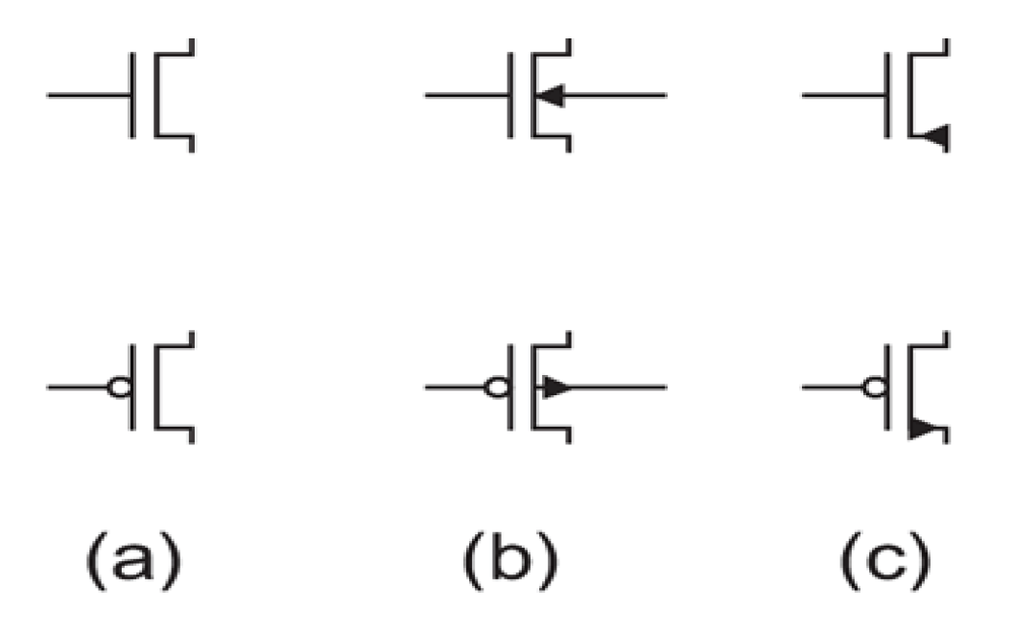
MOS Transistors Symbols
Figure.MOS Transistor Symbols

Slide 6
MOS Transistors
MOS Transistors initially built on a silicon substrate.
Silicon which is a group IV material is the eighth most common element in the universe by mass,
but very rarely occurs as the pure free element in nature.
It is most widely distributed in dusts,
sands, planetoids, and
planets as various forms of silicon dioxide (silica) or silicates.
It forms crystal lattice with bonds to four neighbours.
Silicon is a semiconductor. Pure silicon has no free carriers and conducts poorly.
But adding dopants to silicon increases its conductivity.
If a group V material i.e. an extra electron is added, it forms an n-type semiconductor.
If a group III material i.e. missing electron pattern is formed (hole),
the resulting semiconductor is called a p-type semiconductor.
A junction between p-type and n-type semiconductor forms a conduction path.
Source and Drain of the Metal Oxide Semiconductor (MOS) Transistor is formed by the “doped” regions on the surface of chip.
Oxide layer is formed by means of deposition of the silicon dioxide (SiO2) layer which forms as an insulator and is a very thin pattern

Slide 7
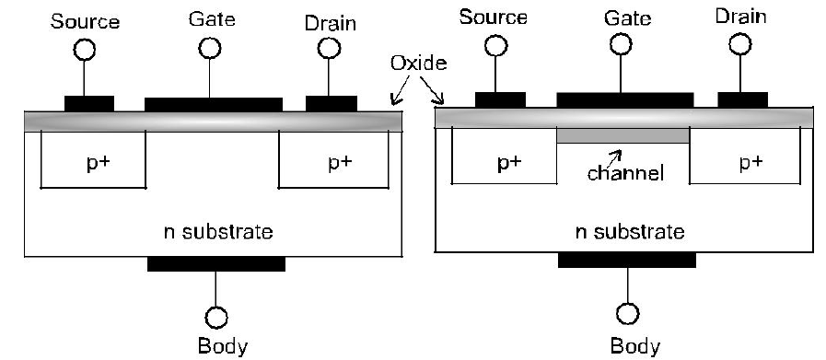
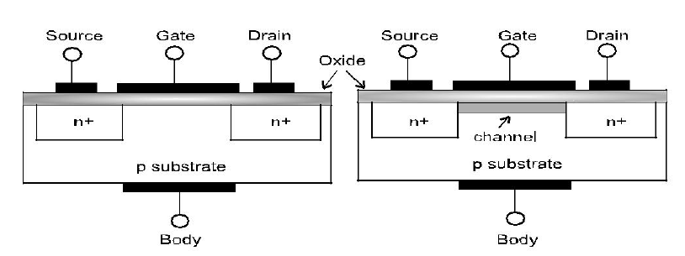
Schematic of PMOS and NMOS Transistors
Figure 1.5 shows the schematic of pMOS and nMOS Transistors with Channel and without Channel.

Slide 8
Working of MOS Transistors
The depletion mode devices are doped
so that a channel exists even with zero voltage from gate to source during manufacturing of the device.
Hence the channel always appears in the device.
To control the channel,
a negative voltage is applied to the gate (for an N-channel device),
depleting the channel, which reduces the current flow through the device.
In essence, the depletion-mode device is equivalent to a closed (ON) switch,
while the enhancement-mode device does not have the built-in channel and is equivalent to an open (OFF) switch.
Due to the difficulty of turning off the depletion mode devices, they are rarely used
The enhancement mode devices do not have the in-built channel.
By applying the required potentials, the channel can be formed.
Also, for the MOS devices, there is a threshold voltage (Vt),
below which not enough charges will be attracted for the channel to be formed.
This threshold voltage for a MOS transistor is a function of
doping levels &
thickness of the oxide layer.
Working of Enhancement Mode Transistor

Slide 9
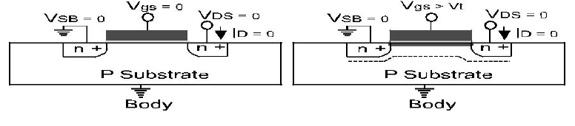
Working of MOS Transistors (Conti..)
When a maximum voltage greater than the threshold voltage Vt (i.e. Vgs > Vt) is applied,
a high concentration of negative charge carriers forms an inversion layer located by a thin layer next to the interface between the semiconductor and the oxide insulator.
This forms a channel between the source and drain of the transistor.
This is shown in the Figure 1.7 (b).
Case 2: Vgs > Vt
Figure 1.7: (b) Formation of Channel for charge transport.

Slide 10
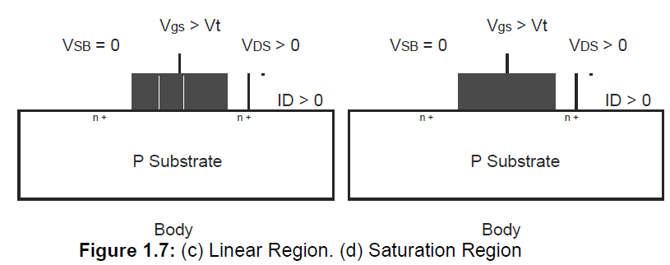
Working of MOS Transistors (Conti..)
A positive Vds reverse biases the drain substrate junction,
hence the depletion region around the drain widens, and
since the drain is adjacent to the gate edge, the depletion region widens in the channel.
This is shown in Figure 1.7 (c).
This results in flow of electron from source to drain resulting in current Ids..
The device is said to operate in linear region during this phase.
Further increase in Vds,
increases the reverse bias on the drain substrate junction in contact with the inversion layer
which causes inversion layer density to decrease.
This is shown in Figure 1.7 (d).
The point at which the inversion layer density becomes very small (nearly zero) at the drain end is termed pinch-off.
The value of Vds at pinch-off is denoted as Vds,sat.
This is termed as saturation region for the MOS device.
Diffusion current completes the path from source to drain in this case,
causing the channel to exhibit a high resistance and behaves as a constant current source.
Figure 1.7: (b) Schematic representation of linear and saturation region.

Slide 11
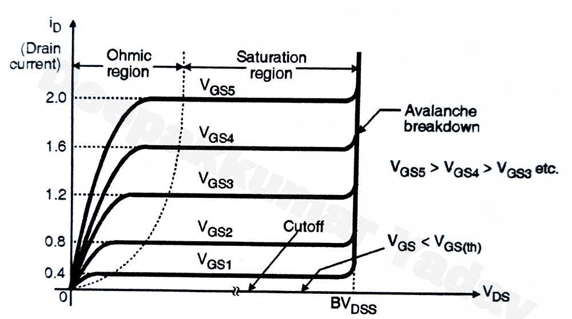
Working of MOS Transistors (Conti..)
The MOSFET ID versus VDS characteristics (V-I Characteristics) is shown in the Figure 1.8.
For VGS < Vt, ID = 0 and device is in cut-off region.
As VDS increases at a fixed VGS,
ID increases in the linear region due to the increased lateral field,
but at a decreasing rate since the inversion layer density is decreasing.
Once pinch-off is reached,
further increase in VDS results in increase in ID;
due to the formation of the high field region which is very small.
The device starts in linear region, and moves into saturation region at higher VDS.
Figure 1.8: Output characteristics of MOS Transistor.

Slide 12
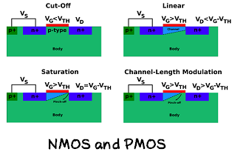
EXAMPLES of Working of pMOS and nMOS

Slide 13
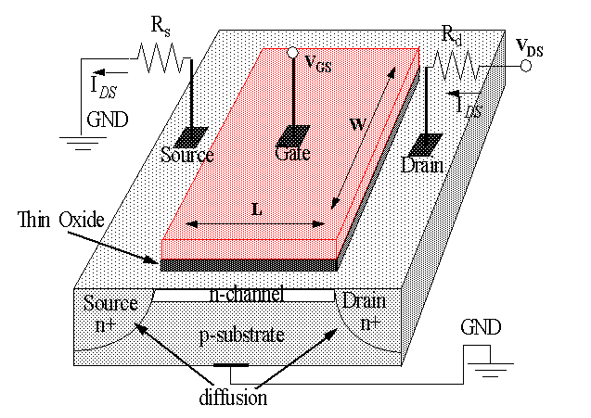
SUMMARY
Metal Oxide Transistors are voltage countertrolled devices. The polarity of Gate voltage is responsible for depletion and enhancement mode.
There are basically two types of MOS transistor pMOS and nMOS.

Slide 14
SELF-ASSESSMENT QUESTIONS
1. Metal Oxide Semiconductor Field Effect Transistor represents for..
Transistor
MOSFET
AC-DC Converter
Resistor
nMOS and pMOS transistor represents for..
n-Channel and p-Channel Mos Transistor
Bipolar Junction Transistor.
n-Channel Diode
All Above

Slide 15
TERMINAL QUESTIONS
1. Discuss the MOS Technology and its importance in VLSI.
2. Discuss the types of MOS Transistors.
3. Describe the working of nMOS and pMOS Transistor.
4. Summarize the various aspects of MOS Technology.

Slide 16
REFERENCES FOR FURTHER LEARNING OF THE SESSION
Reference Books:
1. Sung-Mo Kong, Yusuf Leblebici, “CMOS Digital Integrated Circuits Analysis and Design” Third Edition.
2. Debaprasad Das, “CMOS DESIGN” Second Edition.

Slide 17
THANK YOU
Team – VLSI DESIGN

